Slide 1


Pivotal Big Data Suite
Overview and Use Cases

Slide 2
Pivotal Big Data Suite: Overview

Slide 3
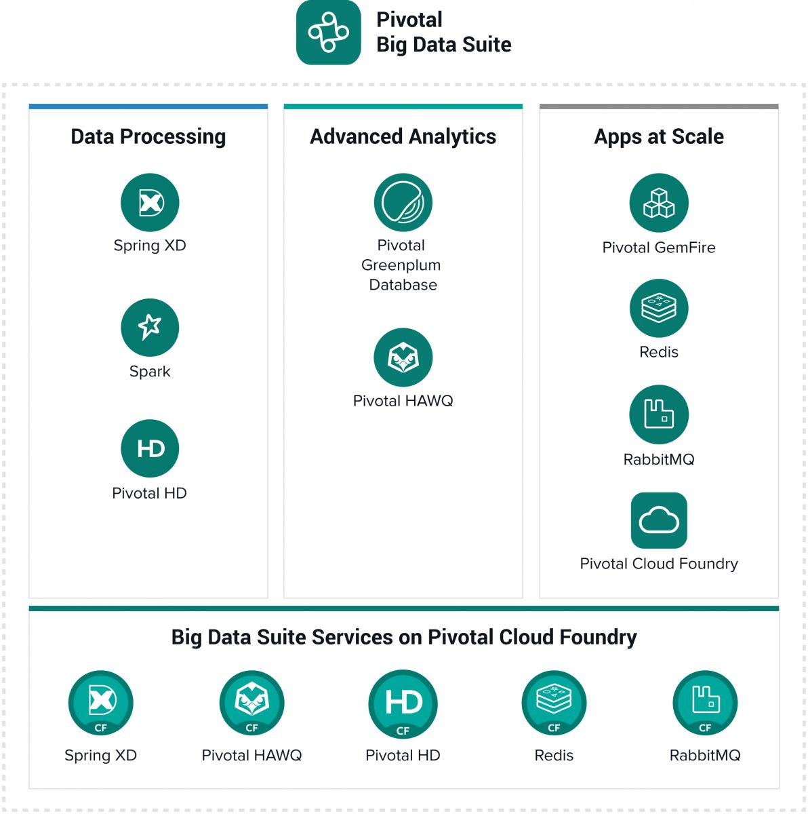

Slide 4
100% Open source
Distributed software
Basket of software
Built to leverage each other

Slide 5
“Glue”
Stream/Batch
Moving data
Distributed

Slide 6
Processing Framework
DAG
Jobs/Streaming
SQL
MLlib

Slide 7
ODP Core
Ambari manager
Spark/HAWQ2/SXD run inside YARN

Slide 8
MPP DB
Stores in HDFS
PXF
ANSI SQL
In-DB Analytics
MADlib
PL/x

Slide 9
In-memory
Data grid
Pure java
Java client or API
Native PDX serialization or JSON

Slide 10
In-memory
Data grid
Pure java
Java client or API
Native PDX serialization or JSON

Slide 12
Pivotal HAWQ Architecture
Node 1
Node 2
Node 3
Node 4
Zoo Keeper
Quorum
Journal
Manager
Zoo Keeper
Quorum
Journal
Manager
Zoo Keeper
Quorum
Journal
Manager
HAWQ Master
HAWQ Secondary Master
NameNode
Secondary NameNode
High speed Interconnect
Node 5
Node 6
Node N
Data Node
Data Node
…
Data Node
HAWQ Segment(s)
HAWQ Segment(s)
HAWQ Segment(s)

Slide 13

Pivotal HAWQ
ANSI SQL compliant built for HDFS
Multi-core query optimizer
Interactive query
Ideal for complex Analytical workloads and predictive analytics
Horizontal scalability
Open Data Format(Parquet)
Notes:
HAWQ has been designed for petabyte scale SQL on Hadoop operation.
Data is stored directly on HDFS and the cost function in the SQL query optimizer is fine-tuned to account for the file system performance profile of HDFS.

Slide 14
Pivotal Big Data Suite: Use Cases

Slide 15












Use Case: Data Movement
Orchestrate workflows
Transform data on-the-fly
Leverage OS technologies
Distributed/fault tolerant
Expose data to tools/apps

Slide 16

Use Case: Operationalize Predictive Models
ANSI SQL
Exploratory data analysis
Data visualization
Statistics
Machine learning
Control movement of data to GemFire
Expose data to app via API or Java client
Minimal latency
High concurrency

Slide 17
Use Case: Leverage Spark for Analytics
GemFire plugin for Spark
GemFire as the DB
Spark as the processing framework
Expose output to app via API or Java Client

Slide 18
Analytics in BDS

Slide 19
Analytics – Analyze Anything
“Gravity” of Data changes everything
Move code, not data
Parallelize everything
Look at entire data set and not just a sample
More data could mean simpler models
Lower the bar for Data Science
Visual modeling
Collaborative modeling

Slide 20




Scalable, In-Database Machine Learning
Open Source https://github.com/madlib/madlib
Works on Greenplum DB, HAWQ and PostgreSQL
In active development by Pivotal
Downloads and Docs: http://madlib.net/

Slide 21
MADlib Advantages
Better parallelism
Algorithms designed to leverage MPP and Hadoop architecture
Better scalability
Algorithms scale as your data set scales
Better predictive accuracy
Can use all data, not a sample
Open source
Available for customization and optimization by user if desired

Slide 22
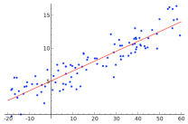
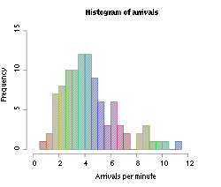
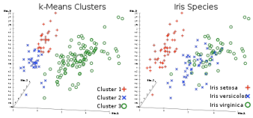
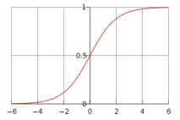
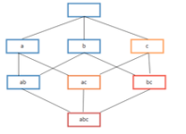
Functions
Predictive Modeling Library
Descriptive Statistics
Sketch-Based Estimators
CountMin (Cormode-Muth.)
FM (Flajolet-Martin)
MFV (Most Frequent Values)
Correlation
Summary
Generalized Linear Models
Linear Regression
Logistic Regression
Multinomial Logistic Regression
Cox Proportional Hazards Regression
Elastic Net Regularization
Robust Variance (Huber-White), Clustered Variance, Marginal Effects
Other Machine Learning Algorithms
Principal Component Analysis (PCA)
Association Rules (Apriori)
Topic Modeling (Parallel LDA)
Decision Trees
Random Forest
Support Vector Machines
Conditional Random Field (CRF)
Clustering (K-means)
Cross Validation
Naïve Bayes
Support Vector Machines (SVM)
Inferential Statistics
Hypothesis Tests
Matrix Factorization
Single Value Decomposition (SVD)
Low Rank
Support Modules
Time Series
ARIMA
Array Operations
Sparse Vectors
Random Sampling
Probability Functions
Data Preparation
PMML Export
Conjugate Gradient
Linear Systems
Sparse and Dense Solvers
Linear Algebra
Oct 2014

Slide 23
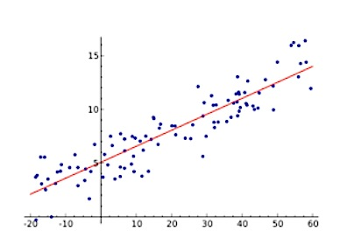
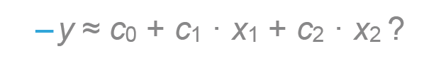
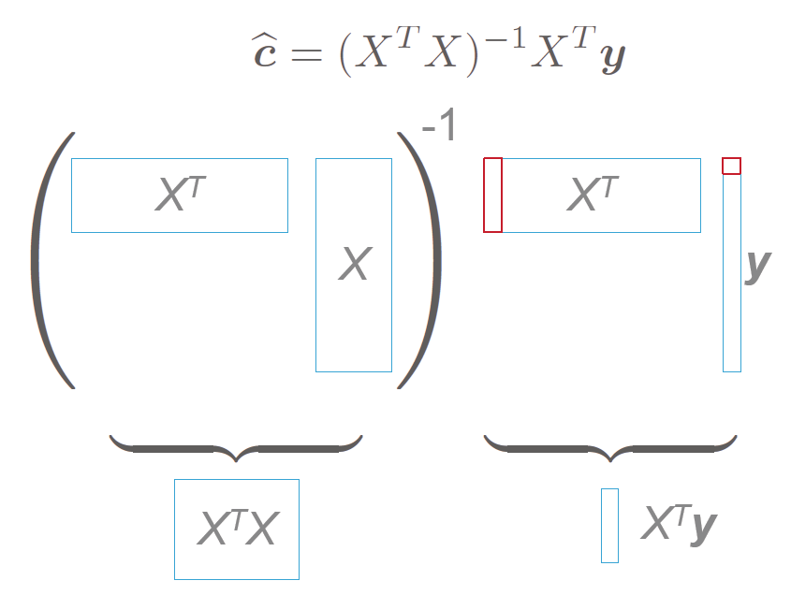
Linear Regression: Streaming Algorithm
Finding linear dependencies between variables
How to compute with a single scan?

Slide 24
Linear Regression: Parallel Computation

Slide 25
Linear Regression: Parallel Computation
Segment 1
Segment 2
Master

Slide 26
Linear Regression: Parallel Computation
Segment 1
Segment 2
Master

Slide 27
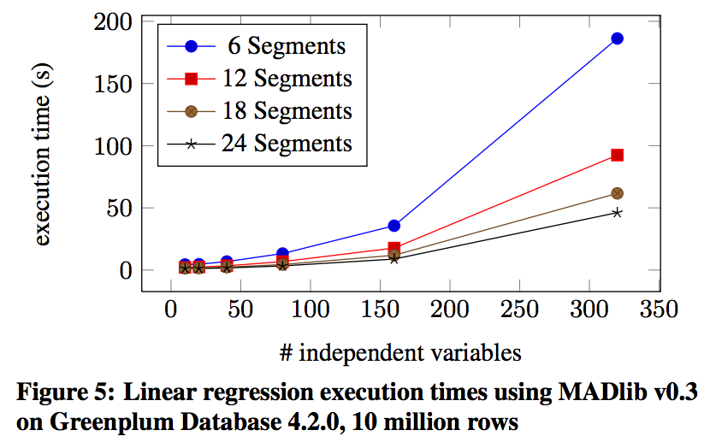
Performing a linear regression on 10 million rows in seconds
Hellerstein, Joseph M., et al. "The MADlib analytics library: or MAD skills, the SQL." Proceedings of the VLDB Endowment 5.12 (2012): 1700-1711.

Slide 28
Calling MADlib Functions: Fast Training, Scoring
Table containing training data
MADlib model function
MADlib allows users to easily and create models without moving data out of the systems
Model generation
Model validation
Scoring (evaluation of) new data
All the data can be used in one model
Built-in functionality to create of multiple smaller models (e.g. classification grouped by feature)
Open-source lets you tweak and extend methods, or build your own
Table in which to save results
SELECT madlib.linregr_train( 'houses’,
'houses_linregr’,
'price’,
'ARRAY[1, tax, bath, size]’);
Column containing dependent variable
Features included in the model

Slide 29
Calling MADlib Functions: Fast Training, Scoring
Table containing training data
MADlib model function
MADlib allows users to easily and create models without moving data out of the systems
Model generation
Model validation
Scoring (evaluation of) new data
All the data can be used in one model
Built-in functionality to create of multiple smaller models (e.g. classification grouped by feature)
Open-source lets you tweak and extend methods, or build your own
Table in which to save results
SELECT madlib.linregr_train( 'houses’,
'houses_linregr’,
'price’,
'ARRAY[1, tax, bath, size]’,
‘bedroom’);
Column containing dependent variable
Features included in the model
Create multiple output models (one for each value of bedroom)

Slide 30
Calling MADlib Functions: Fast Training, Scoring
MADlib allows users to easily and create models without moving data out of the systems
Model generation
Model validation
Scoring (evaluation of) new data
All the data can be used in one model
Built-in functionality to create of multiple smaller models (e.g. classification grouped by feature)
Open-source lets you tweak and extend methods, or build your own
SELECT madlib.linregr_train( 'houses’,
'houses_linregr’,
'price’,
'ARRAY[1, tax, bath, size]’);
MADlib model scoring function
SELECT houses.*, madlib.linregr_predict(ARRAY[1,tax,bath,size], m.coef
)as predict
FROM houses, houses_linregr m;
Table with data to be scored
Table containing model

Slide 31
PivotalR

Slide 32
PivotalR: Bringing MADlib and HAWQ to a familiar R interface
Challenge
Want to harness the familiarity of R’s interface and the performance & scalability benefits of in-DB analytics
Simple solution:
Translate R code into SQL
Pivotal R
SQL Code
d <- db.data.frame(”houses")
houses_linregr <- madlib.lm(price ~ tax
+ bath
+ size
, data=d)
SELECT madlib.linregr_train( 'houses’,
'houses_linregr’,
'price’,
'ARRAY[1, tax, bath, size]’);
https://github.com/pivotalsoftware/PivotalR

Slide 33


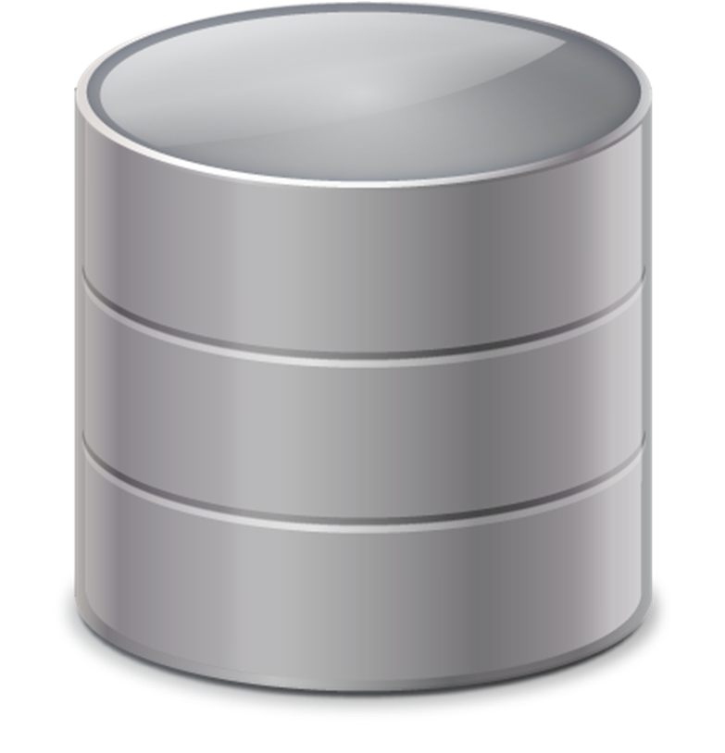

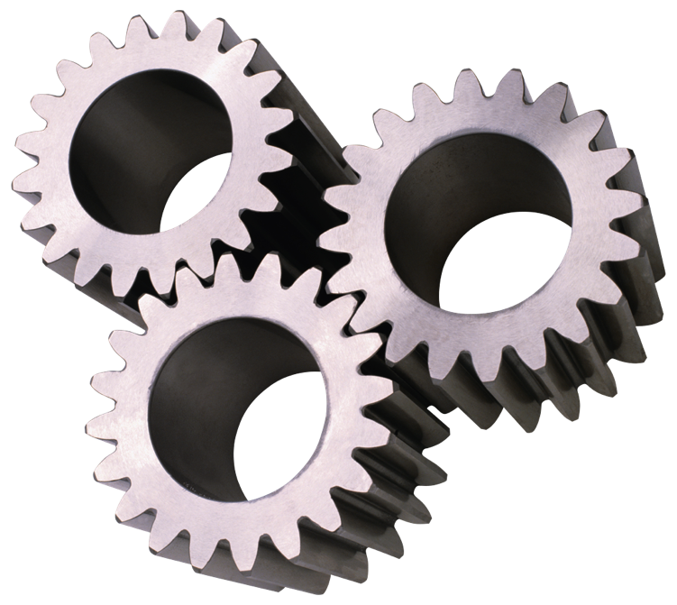
PivotalR Design Overview
Call MADlib’s in-DB machine learning functions directly from R
Syntax is analogous to native R function
RPostgreSQL
PivotalR
2. SQL to execute
1. R → SQL
Database/Hadoop
w/ MADlib
3. Computation results
No data here
Data doesn’t need to leave the database
All heavy lifting, including model estimation & computation, are done in the database
Data lives here

Slide 34






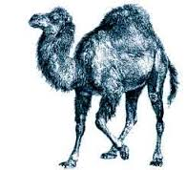
PL/X : X in {pgsql, R, Python, Java, Perl, C etc.}
Allows users to write Greenplum/PostgreSQL functions in the R/Python/Java, Perl, pgsql or C languages
SQL
Master
Host
Standby
Master
The interpreter/VM of the language ‘X’ is installed on each node of the Greenplum Database Cluster
Interconnect
Segment Host
Segment
Segment
Segment Host
Segment
Segment
Segment Host
Segment
Segment
Segment Host
Segment
Segment
Data parallelism:
PL/X piggybacks on Greenplum’s MPP architecture
…
Notes:
Owner: Vatsan

Slide 35
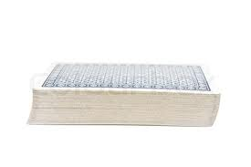

Data Parallelism
If you can break up the problem into a number of parallel tasks, and there exists no dependency (or communication) between those parallel tasks
Also known as ‘explicit parallelism’
Parallel data chunks must be less than ~1GB (practical limit may be smaller)
Example:
Count a deck of cards by dividing it up between people (i.e., count in parallel)

Slide 36

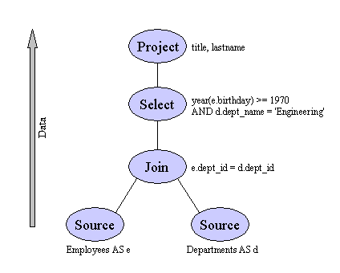

Parallelized R in Pivotal via PL/R: An Example
SQL & R
TN
Data
CA
Data
NY
Data
PA
Data
TX
Data
CT
Data
NJ
Data
IL
Data
MA Data
WA
Data
TN Model
CA Model
NY Model
PA Model
TX Model
CT Model
NJ Model
IL
Model
MA Model
WA
Model
Parsimonious – R piggy-backs on Pivotal’s parallel architecture
Minimize data movement
Build predictive model for each state in parallel

Slide 37

Use Case: RabbitMQ as Source
Messages can come from virtually anywhere
e.g. HTTP, flat files, python, Java
Many formats
Persistent/fault tolerant
Easy organization of queues
Many-to-many
Constantly poll for new messages
On-the-fly transformations
Sink to database

Slide 38
Use Case: Processing files periodically
Files dumped to HDFS or Unix FS
Batch: periodically process all files
Stream: constantly poll for new files
Transform and move data
GemFire for fast data
HAWQ for analytics use cases
PHD for archiving

Slide 39






Use Case: NLP/NBO Demo
Customer Facing
Internal
Purchase
Real-time View
Customers
Next Offer
Business
Customer’s Transaction
Next Offer
Gemfire CQ,
Push Notifications
2
Trans + Offer
2
Reports
Src
Cleanse
Predict
Src
Transactions
Cleanse
Predict
Src
Analysts, Data Scientists
& Ad-hoc queries

Slide 40
Use Case: NLP/NBO Demo
2
2
Customer Facing
Internal
Purchase
Real-time View
Customers
Next Offer
Business
Customer’s Transaction
Next Offer
Gemfire CQ,
Push Notifications
PMML
Trans + Offer
Model Creation
&
Training
2
Reports
Src
Cleanse
Predict
HAWQ Tables
Src
Micro
Batch
HDFS Staging
Transactions
Cleanse
Predict
Src
Analysts, Data Scientists
& Ad-hoc queries

Slide 41




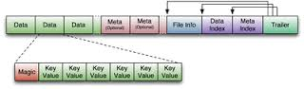
Use Case: IoT Architecture
Customer 1
Customer
Site
Third Party
BI / Visualization Tools
Customer
Site
Data
Lake
HAWQ
.
.
.
On-Premise
Rabbit MQ Cluster
QUERY
Spring XD
HDFS
Customer
Site
Other Data Sources

Slide 42
Use Case: Leverage Spark for Analytics
GemFire plugin for Spark
GemFire as the DB
Spark as the processing framework
Expose output to app via API or Java Client

Slide 43
Spark with BDS Software
In-memory storage
Web App touch point
Compute Engine
Sophisticated Event Handling
Machine Learning
SQL
Streaming

Slide 44
Spark with BDS Software
Orchestration/Scheduling
Data Routing
Compute Engine
Data Processing/Prep
Machine Learning
SQL
Streaming
PMML
PMML
Unified experience

Slide 45
Pivotal Big Data Suite: Demo

Slide 46
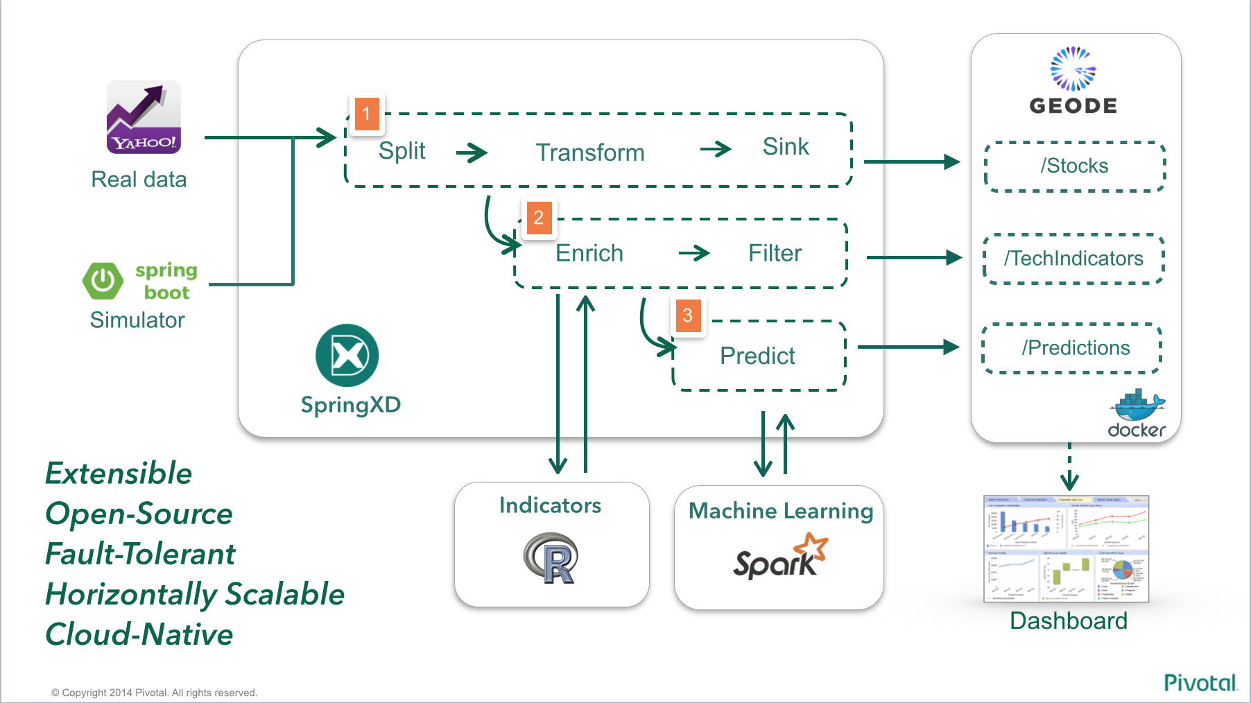
Demo Architecture

Slide 47
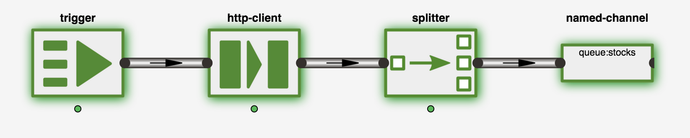

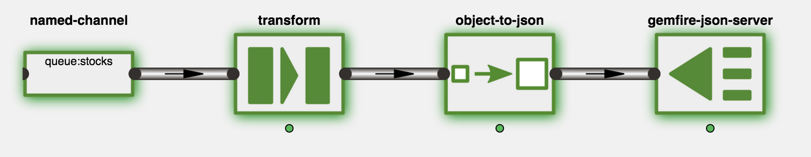


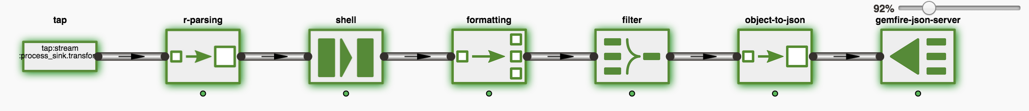

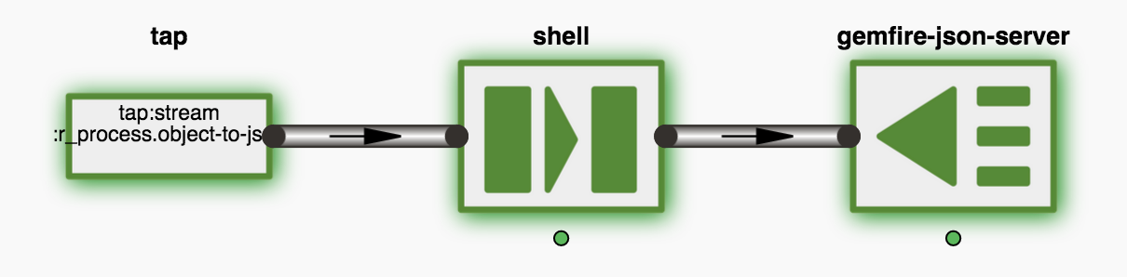
Stream ‘Flo’ Diagrams
Process/Store
Enrich
Predict

Slide 48
Stream: yahoo_finance_source
Process/Store
Enrich
Predict

Slide 49
Stream: process_sink
Process/Store
Enrich
Predict

Slide 50
Stream: r_process
Process/Store
Enrich
Predict

Slide 51
Stream: prediction
Process/Store
Enrich
Predict

Slide 52
Streams
Process/Store
Enrich
Predict

